Slide 1


VirtusaPolaris Digital
Transforming Today’s Financial Services Firms Into Tomorrow’s Market Leaders
16th June 2017

Slide 2
Who We Are A Really Punchy Description Here!
01

Slide 3
Placeholder for a pre-existing slide that emphasises our BFS and AEM credentials
Who we are

Slide 4
Placeholder for a pre-existing slide, about the company, location, etc.
Who we are

Slide 5
Customer Engagement at ANZ Challenge and Opportunity
02

Slide 6
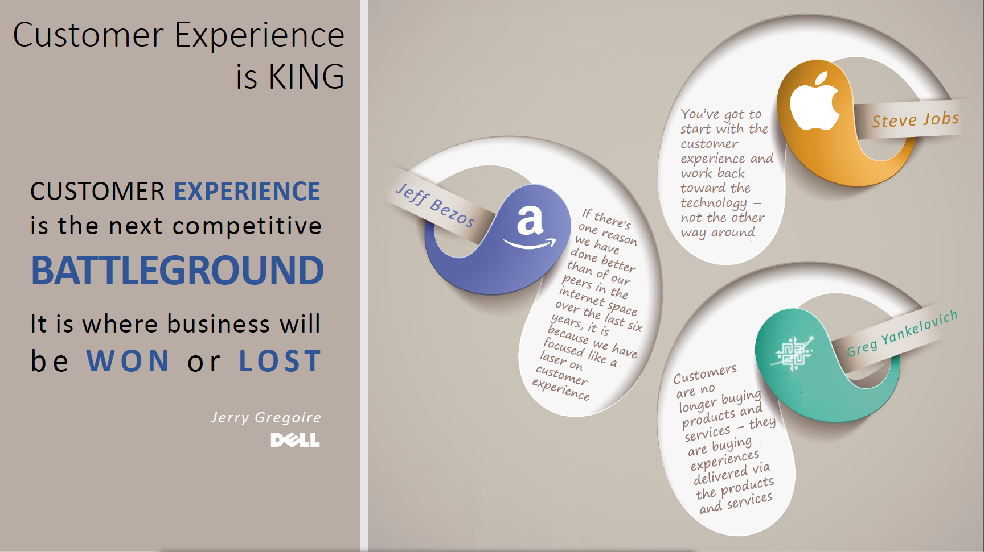
Notes:
Need something punchy, high level about the overall challenge & opportunity in this area

Slide 7
Call out specific risks/challenges relevant to ANZ, business motivations, and advantages from technology that we reference later.
Challenge and opportunity

Slide 8
Scenario One Personal Banking
03

Slide 9
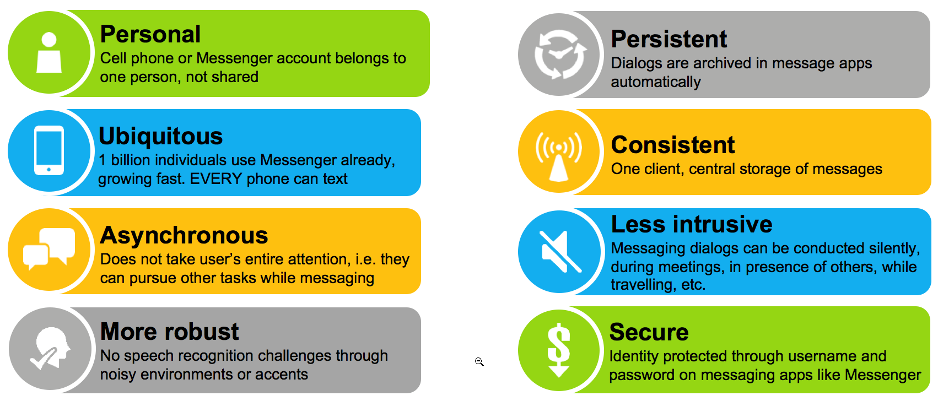

Account Switching Service
Scenario one – Personal banking
Attracting New Customers via Social Media and Chatbots
Amelia is reviewing her FaceBook feed, and is approached by the ANZ Chatbot to discuss account switching.
The Chatbot intelligently captures her information in conversation, and encourages her to agree to switch accounts.
Amelia is redirected to a form that is pre-filled with her information, and just requires a few clicks to proceed.
Amelia immediately receives a require to digitally sign the form, which she does, and the Document of Record is captured.

Slide 10
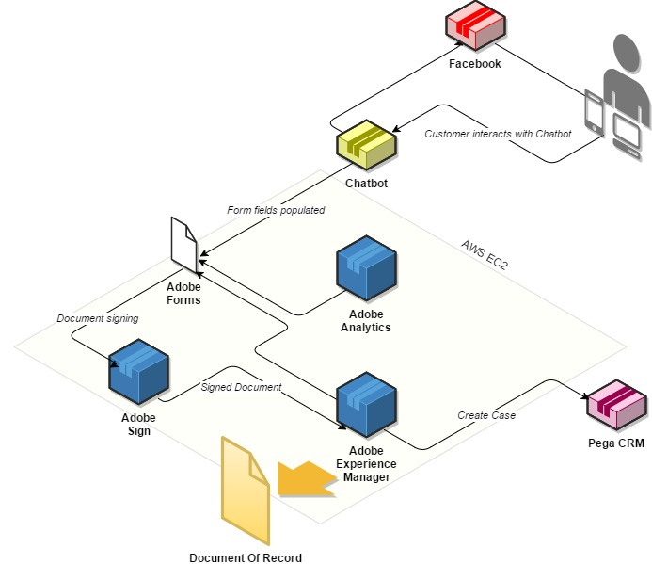
Account Switching Service - Technical Overview
SCENARIO ONE – personal banking
Chatbot
Blurb about particular features we’re using
Why and how
Facebook
Blurb about particular features we’re using
Why and how
Adobe Sign
Blurb about particular features we’re using
why and how
Adobe Experience Manager
Blurb about particular features we’re using
Why and how
Adobe Forms
Blurb about particular features we’re using
why and how

Slide 11
Scenario Two Retail/Corporate Banking
04

Slide 12
Placeholder for standing order
Scenario two – retail banking

Slide 13
SCENARIO ONE – RETAIL/CORPORATE banking
UPDATE FOR THIS SCENARIO

Slide 14
Scenario Three Private Banking
05

Slide 15
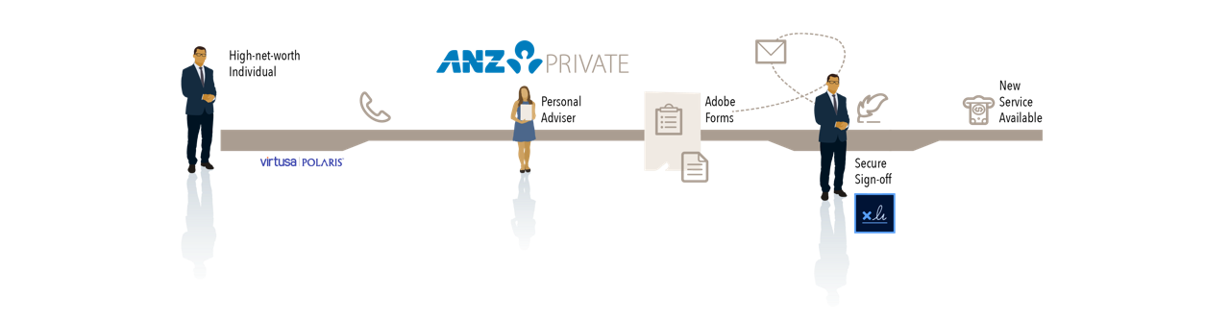
Private Banking - Wealth Portfolio Application
Scenario three – Private banking
Interacting with HNW Customers Efficiently and Effectively
Oliver is a HNW customer, he calls his Fund Manager to discuss possible new investments.
The Fund Manager directs him to a form that is partially completed with his information, and some additional questions that quickly narrow down the choice of portfolio.
On submission the form is converted to digital form and sent out to Oliver and the Fund Manager for signature
Both parties sign it, and the Document of Record is captured.

Slide 16
SCENARIO ONE – PRIVATE banking
UPDATE FOR THIS SCENARIO

Slide 17
Final Thoughts Future Opportunities
06

Slide 18
Thank You
www.virtusapolaris-digital.com

